Slide 1

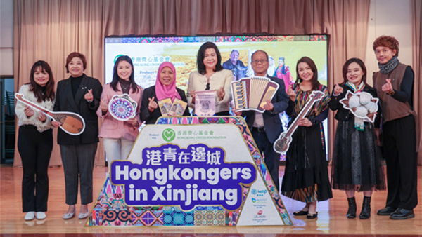
KYK FOUNDATION
Website Platform
Building Cultural Bridges Between
Hong Kong and Pakistani Communities

Slide 2
PRESENTATION OVERVIEW
What We'll Explore Today
01
Project Mission & Vision
02
Website Architecture
Understanding KYK Foundation's commitment to cultural harmony and community building
Complete system overview with page structure and navigation flow
03
User Personas & Stories
04
User Flow Diagrams
Who we serve and their unique needs, motivations, and goals
UML diagrams visualizing workshop discovery and donation journeys
05
Workshop System
06
Donation Platform
Three cultural workshops: Urdu, Milk Tea, and Henna experiences
Seamless giving experience with receipt options and transparency
07
Technical Implementation
08
Impact & Future Vision
Django framework architecture, models, and scalable design patterns
Real impact stories and the path toward a more inclusive Hong Kong

Slide 3
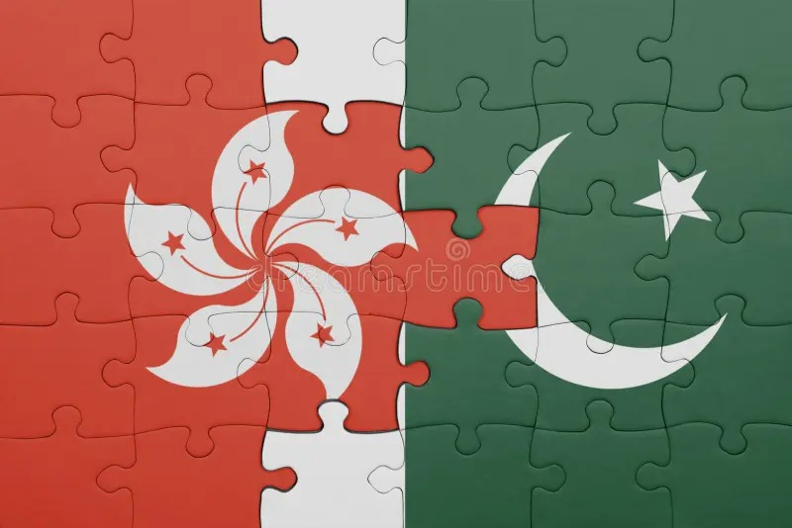
PROJECT MISSION
Bridging Two Cultures
Our Core Vision
KYK Foundation promotes harmony between Hong Kong people and Pakistanis in HK through cultural exchange, education, and community engagement. We believe that understanding builds bridges, and learning creates lasting connections.
Founder's Vision
Fung Chin San established KYK Foundation with a simple yet powerful belief: an inclusive society where both communities learn from and support each other . Her dedication to building a caring Hong Kong inspires every aspect of our work.
“Let’s build a caring and inclusive society in Hong Kong together."
Community Impact
Through workshops, donations, and direct engagement, we're creating meaningful opportunities for cultural appreciation and mutual understanding. Every interaction strengthens the fabric of our diverse community.
Fung Chin San
Founder, KYK Foundation

Slide 4
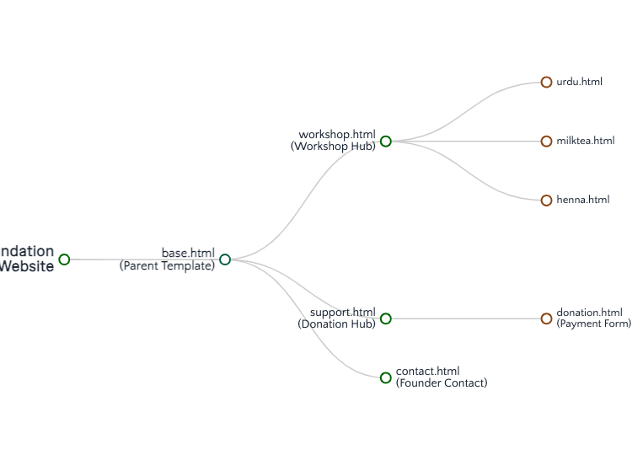

SYSTEM OVERVIEW
Website Architecture
Complete Django-based platform structure with 7 core pages
Template Structure
Django template inheritance with base.html as the parent template, extended by all child pages for consistent UI/UX.
7 Core Pages
Workshop Listing
Urdu Workshop
Milk Tea Workshop
Henna Workshop
Support Page
Donation Form
Contact Page
Tech Stack
Django
Python
Bootstrap
HTML/CSS
JavaScript

Slide 5
USER RESEARCH
User Personas: Who We Serve
Three primary user groups with unique needs, motivations, and goals
Persona 01
Persona 02
Persona 03
Cultural Explorers
Community Builders
Supporters
HK Locals Seeking Cultural Knowledge
Pakistanis Sharing Their Heritage
Donors & Workshop Participates Committed to the Mission
Demographics:
Demographics:
Demographics:
Age 25-45, professionals, curious about diverse cultures
Pakistani residents in HK, fluent in Urdu and can communicate in simple English, skilled in traditional arts
Philanthropists, CSR professionals, community advocates
Goals:
Goals:
• Learn Urdu basics for community connection
• Experience authentic Pakistani traditions
• Build meaningful cross-cultural relationships
Goals:
• Support cultural harmony initiatives
• Make tax-deductible contributions
• See tangible impact of donations
• Share Pakistani culture with HK community
• Build bridges through teaching
• Foster mutual understanding and respect
Pain Points:
Pain Points:
Limited access to authentic cultural learning opportunities
Pain Points:
Complex donation processes, Lack of transparency
Limited platforms to showcase cultural expertise
How We Help: Hands-on workshops expert tutors
How We Help: Tutor opportunities with visibility
How We Help: Easy giving with receipt options

Slide 6
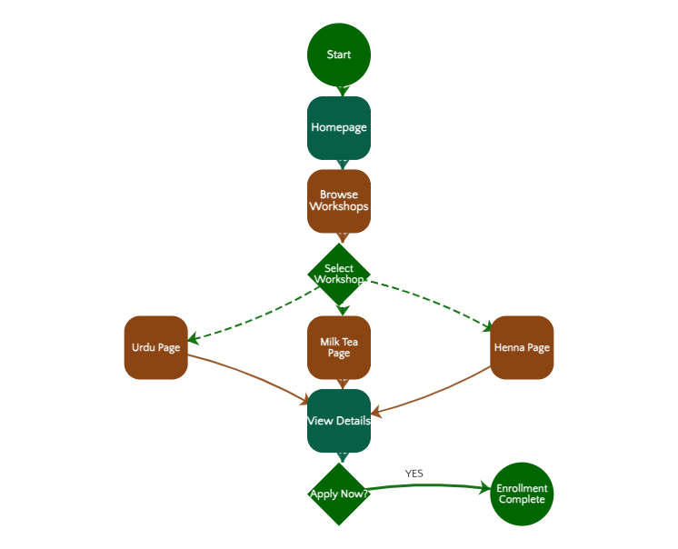
USER FLOW ANALYSIS
User Journey: Workshop Discovery Flow
UML Activity Diagram showing the complete path from discovery to enrollment
Flow Overview
Users navigate from homepage → workshop listing → individual workshop pages → enrollment completion in a seamless 4-step journey.
Key Decision Points
1
Workshop Selection: The user chooses among 3 cultural experiences based on their preference
2
Apply Decision: After viewing tutor profiles and details
Journey Metrics
Total Steps
7 actions
Avg. Time
3-5 minutes
Click Depth
3 clicks max
UX Best Practice
Clear navigation within 3 clicks ensures high completion rates and user satisfaction.

Slide 7
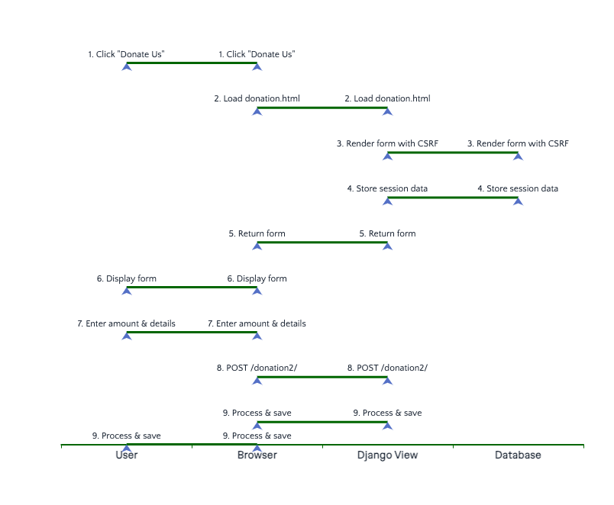
DONATION SYSTEM
User Journey: Donation Flow
UML Sequence Diagram showing system interactions and data flow
Sequence Flow
User → Website → Server interactions showing how donation data flows through the system with validation and confirmation.
Process Steps
1
Navigate to Support
2
Click Donate button
3
Enter amount (HKD)
4
Select receipt option
5
Fill personal details
6
Submit with CSRF
7
Receive confirmation
Security Features
CSRF token protection
Form validation
Secure POST method
Modal confirmation
Receipt option conditionally enables name/email fields via JavaScript.

Slide 8
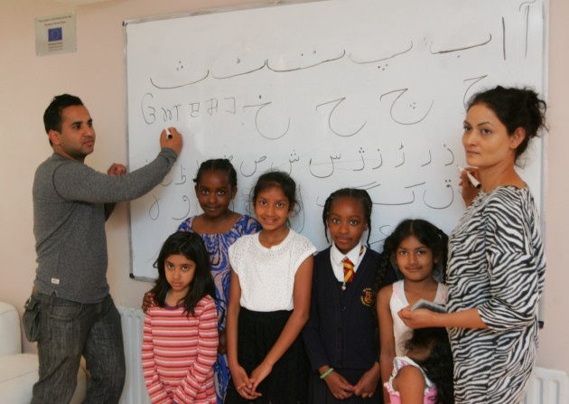
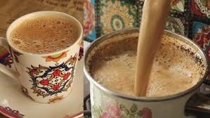
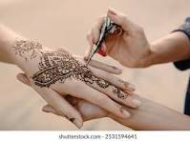
CULTURAL EXPERIENCES
Workshop System: Cultural Learning Hub
Three immersive workshops connecting communities through authentic cultural experiences
LANGUAGE
CULINARY
ART
Urdu Class for Beginners
Pakistani Milk Tea Workshop
Pakistani Henna Workshop
"Wanna learn Urdu?"
"How to make traditional Pakistani milktea?"
"Wanna draw henna on your hands?"
Urdu is the mother language of Pakistanis. Learn this beautiful language with our expert tutor.
Tailor-made for foodies interested in Pakistani cuisine. Learn authentic brewing from a Pakistani Mama.
Learn beautiful henna art from our skilled tutor. Step-by-step guidance for stunning designs.
Aness Ali
Umza Khan
Zahraa Ahmed
Expert Tutor
Master Brewer
Master Artist
Apply Now
Apply Now
Apply Now
Workshop Impact
3
3
∞
Creating meaningful cultural exchange opportunities
Workshops
Expert Tutors
Connections

Slide 9

SUPPORTING THE MISSION
Donation Platform: Easy & Transparent Giving
Seamless donation experience with receipt options and full transparency
Donation Form Features
Amount Input
Receipt Option
HKD currency with numeric validation and minimum amount check
Checkbox enables name/email fields via JavaScript conditionally
Why Donations Matter
Your support helps us continue Kung Yung Koon's spirit of community service and cultural bridge-building.
Personal Info
Confirmation
First name, last name, and email for receipt generation
Thank You modal with heartfelt message and close button
Fund workshop materials and venues
Support tutor compensation
Expand community outreach programs
Smart Form Logic
Security & Trust
// JavaScript conditional field enabling
•
CSRF Protection: Django's built-in security tokens prevent cross-site attacks
receiptCheckbox.addEventListener('change', () => {
Form Validation: Server-side validation ensures data integrity
firstName.disabled = !receiptCheckbox.checked;
•
lastName.disabled = !receiptCheckbox.checked;
•
Transparent Process: Clear donation flow builds donor confidence
email.disabled = !receiptCheckbox.checked;
});
Fields are dynamically enabled/disabled based on receipt preference, creating a cleaner user experience.
"Thank you so much for your sincere donation to KYK Foundation."

Slide 10
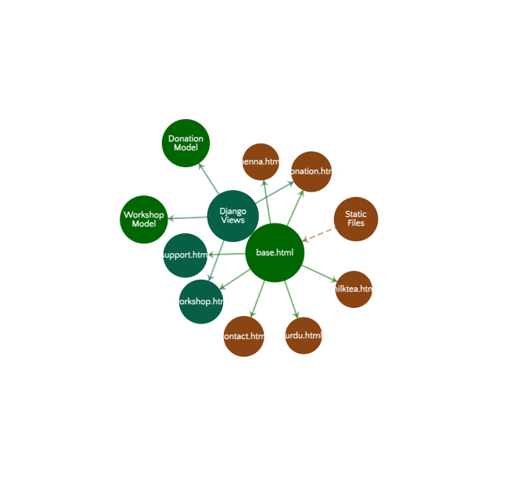
TECHNICAL ARCHITECTURE
Technical Implementation: Django Framework
Scalable architecture with modular design patterns and clean code structure
Architecture Overview
Django's MTV (Model-Template-View) pattern ensures clean separation of concerns and maintainable codebase.
Database Models
Workshop Model
workshop, ws_photo, tutor_name, tutor_photo, quote, detail, experience, tagline
Donation Model
contribute_fund, receipt, first_name, last_name, email, timestamp
URL Routing
path('workshops/', workshops_list)
path('urdu/', urdu_detail)
path('donation/', donation_form)
path('contact/', contact_page)
Static Files
images/ (workshop photos)
css/ (Bootstrap + custom)
js/ (form interactions)

Slide 11
AGILE DEVELOPMENT
User Stories: Real Impact
User-centered stories driving feature development and platform improvements
CULTURAL EXPLORER
COMMUNITY BUILDER
Learn Urdu Basics
Share Cultural Heritage
"As a HK resident, I want to learn Urdu basics, so that I can communicate with Pakistani neighbors and build meaningful community connections."
"As a Pakistani resident, I want to teach traditional arts, so that I can share my heritage and foster cross-cultural understanding in Hong Kong."
Solution: Urdu Workshop with expert tutor
Solution: Tutor platform with visibility & recognition
SUPPORTER
ALL USERS
Receive Tax Receipt
Access on Mobile
"As a donor, I want to receive a receipt, so that I can claim tax benefits and have official documentation of my contribution."
"As a mobile user, I want to browse workshops on my phone, so that I can engage anytime, anywhere without needing a desktop computer."
Solution: Optional receipt with conditional fields
Solution: Bootstrap responsive design framework
CULTURAL EXPLORER
SUPPORTER
Trust Tutor Credentials
Easy Donation Process
"As a workshop participant, I want to see tutor credentials, so that I trust the learning experience and feel confident in the quality of instruction."
"As a potential donor, I want to donate quickly and easily, so that I can support the mission without navigating complex forms or processes."
Solution: Floating tutor cards with photos & bio
Solution: Streamlined 3-step donation flow

Slide 12

KYK FOUNDATION
Building Harmony,
One Connection at a Time
KYK Foundation's website is more than a digital platform—it's a bridge connecting hearts and minds. Through workshops, donations, and community engagement, we're creating a Hong Kong where cultural diversity is celebrated and every voice is heard.
Education
Connection
Harmony
Learning opens doors to understanding
Relationships build strong communities
Together we create an inclusive future
"Join us in building a more inclusive future."
Contact Founder
fungchinsan@mail.com

Slide 13



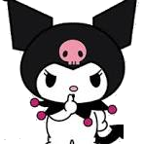



Special thanks to:
Fung Chin San_Final Project_Erb8_4

